Slide 1
Code Review: Why and How
Living with “the invisible methods section”
Andy Boughton
Center for Statistical Genetics
October 2020

Slide 2

Why Code Review: Project Benefits
Many research articles depend on methods implemented via code
In addition to implementing equations, code must make many decisions (missing / imputed data, sample selection, underflow, etc)
Reading the methods section is not enough to validate the program
...but a code bug is enough to invalidate the conclusions of the paper
Code review helps us to do good science today
Soergel, D. A. W. Rampant software errors may undermine scientific results. F1000Res 3, 303 (2015). (link)
Chang, G. et al. Retraction. Science 314, 1875.2-1875 (2006). (link)
Jay, C. et al. The challenges of theory-software translation. F1000Res 9, 1192 (2020). (link)

Slide 3

Why Code Review: Developer Benefits
Share new ideas and techniques so that developers aren’t solving the same problems in isolation
Reduce “bus factor”: share critical information so that key pieces can be found, run, and maintained by other people
Software and data are complex: catch subtle bugs/ edge cases
Code review helps us to do good science tomorrow
Kemerer, C. F. & Paulk, M. C. The Impact of Design and Code Reviews on Software Quality: An Empirical Study Based on PSP Data. IIEEE Trans. Software Eng. 35, 534–550 (2009). (link)

Slide 4
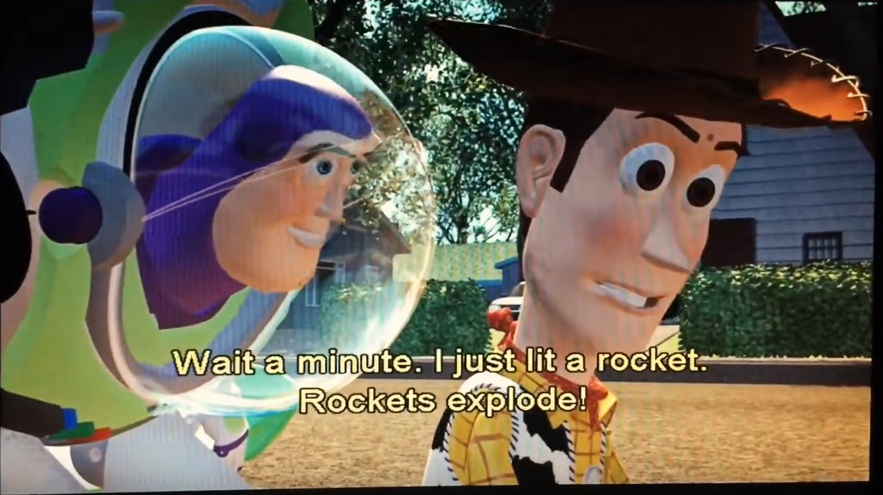
Credit: Disney/ Pixar, Toy Story. 1995

Slide 5
How to pick a good reviewer
Code review is peer review!
Should understand the basic language and tools
Sufficient domain knowledge to determine intent of the code
Code review requires practice: everyone should take turns
Petre, M. & Wilson, G. Code Review For and By Scientists. arXiv:1407.5648 [cs] (2014). (link)

Slide 6
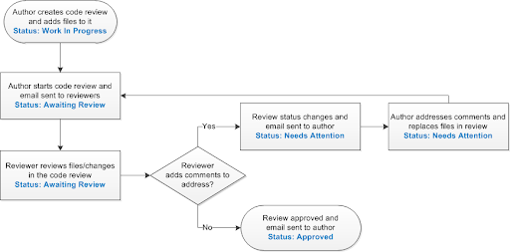
Code review workflow
Credit: http://help.seapine.com/surround/2013.2.0/scmclient/Content/UserGuide/AboutCodeReviewProcess.htm
Notes:
Not shown on the diagram: every now and then a change doesn’t get merged; it just gets abandoned. Figure that out early, be honest about why, and clear up the “needs attention” flag so you can focus on what matters.

Slide 7
The role of the Reviewer

Slide 8
Prepare before commenting
Wait until the code is ready (not “draft” / “work in progress”)
If automated checks fail, send it back
Read the pull request description to understand the feature + any required setup
Fetch the branch and make sure it runs.
Are the required input files available?
Do docs and build/deployment scripts work as written?
Does the program produce the expected output?
Strategies for reading code:
https://selftaughtcoders.com/how-to-quickly-and-effectively-read-other-peoples-code/

Slide 9
Give clear feedback
Make comments targeted and actionable:
Instead of “everything is confusing”, say “what if we tried x?”
Instead of “50 errors reported by tool”, rate impact: which are severe?
Suggestions, not mandates
Share learning:
Provide references when introducing new concepts
Praise a new or interesting idea
Take advantage of review tools like GitHub:
“Suggest change” features make it easy to incorporate small revisions

Slide 10
Intermission: Language exercise
Why would you use THAT function?!
Try: Should this be other_function instead?
This is incredibly sloppy work
Try: It would be helpful if there were tests. Please consider cleaning up the unused code before submitting, as this will make it easier to review and maintain.
Is this supposed to do anything other than make me cry?
Try: I am having trouble following this function. Can it be simplified? If not, a docstring may be helpful for future reference.
Guidelines:
Discuss the code, not the person
Phrase as a question: leave room for different (good) alternatives
Be clear about what is suggested
Show the intended benefit
Ask questions to learn, not to attack

Slide 11
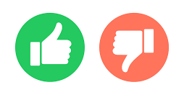
Finalizing a review
Triage your requests:
Mandatory fix vs nice to have
What is achievable with current resources?
Summarize comments: make concise and readable
Define an action plan: Be willing to negotiate timelines and responsibility
Schedule follow up if necessary

Slide 12
The role of the code author

Slide 13
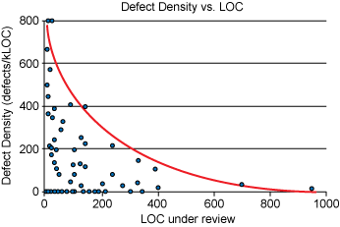
Think incrementally
Design or strategy questions can be discussed before formal review
Clean up code as you go- continuous self improvement
Don’t overwhelm the reviewer: split code and reviews into small pieces; reviews are routine instead of rare
“...reviewing faster than 400 LOC per hour results in a severe drop-off in effectiveness.”
https://www.ibm.com/developerworks/rational/library/11-proven-practices-for-peer-review/index.html

Slide 14
Preparing code to be reviewed
Verify that code runs and look at UI. (don’t assume it will work)
Track required changes (can/should they be automated?)
Database migrations, dependency upgrades, system configuration, etc
Write testing notes: help the reviewer identify areas where you want feedback
Create automated validation (unit tests) if possible
Capture required artifacts- provide small test data when “archive” / “private” folders are not accessible

Slide 15
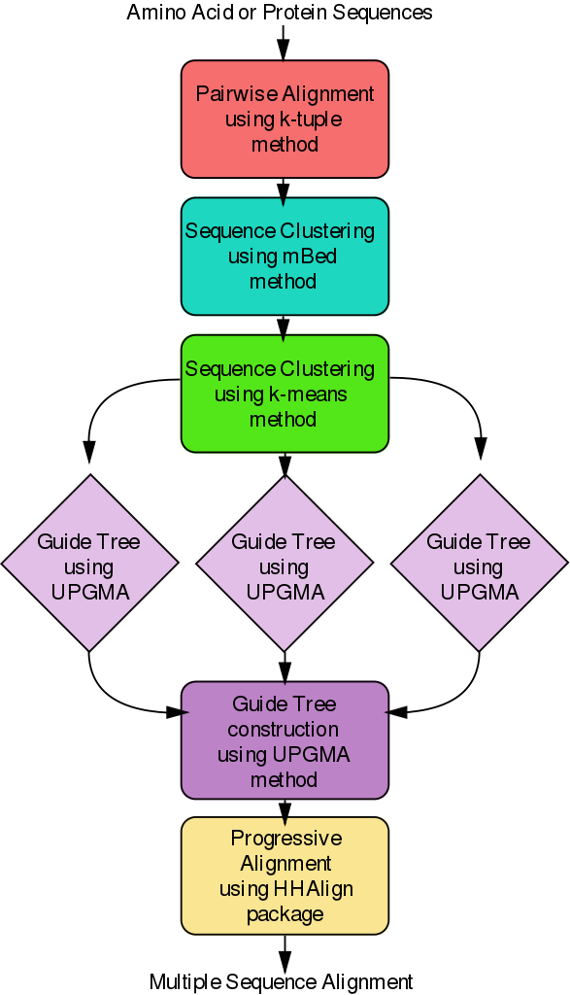
There is more than one way to convey your algorithm and intent to the reviewer.
More information: https://www.lucidchart.com/pages/uml-activity-diagram
Credit: https://commons.wikimedia.org/wiki/File:Clustal_Omega_Algorithm_Flowchart.svg

Slide 16
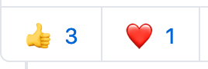
Responding to review
Code review comments are a dialogue
You don’t need to say yes to everything; justify your choices
Be courteous and thorough. Did you cover all major points?
Be prepared to discuss specifics if necessary
Triage: can these changes be made separately later?
Follow through on your promises
Don’t leave the problem for your reviewer to fix
TIP: GitHub emoji can act like checkmarks on individual points- “I saw this”, “I responded to this one”

Slide 17
The role of the Team

Slide 18
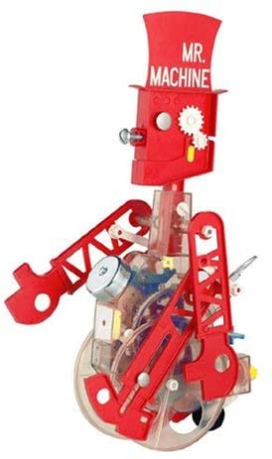



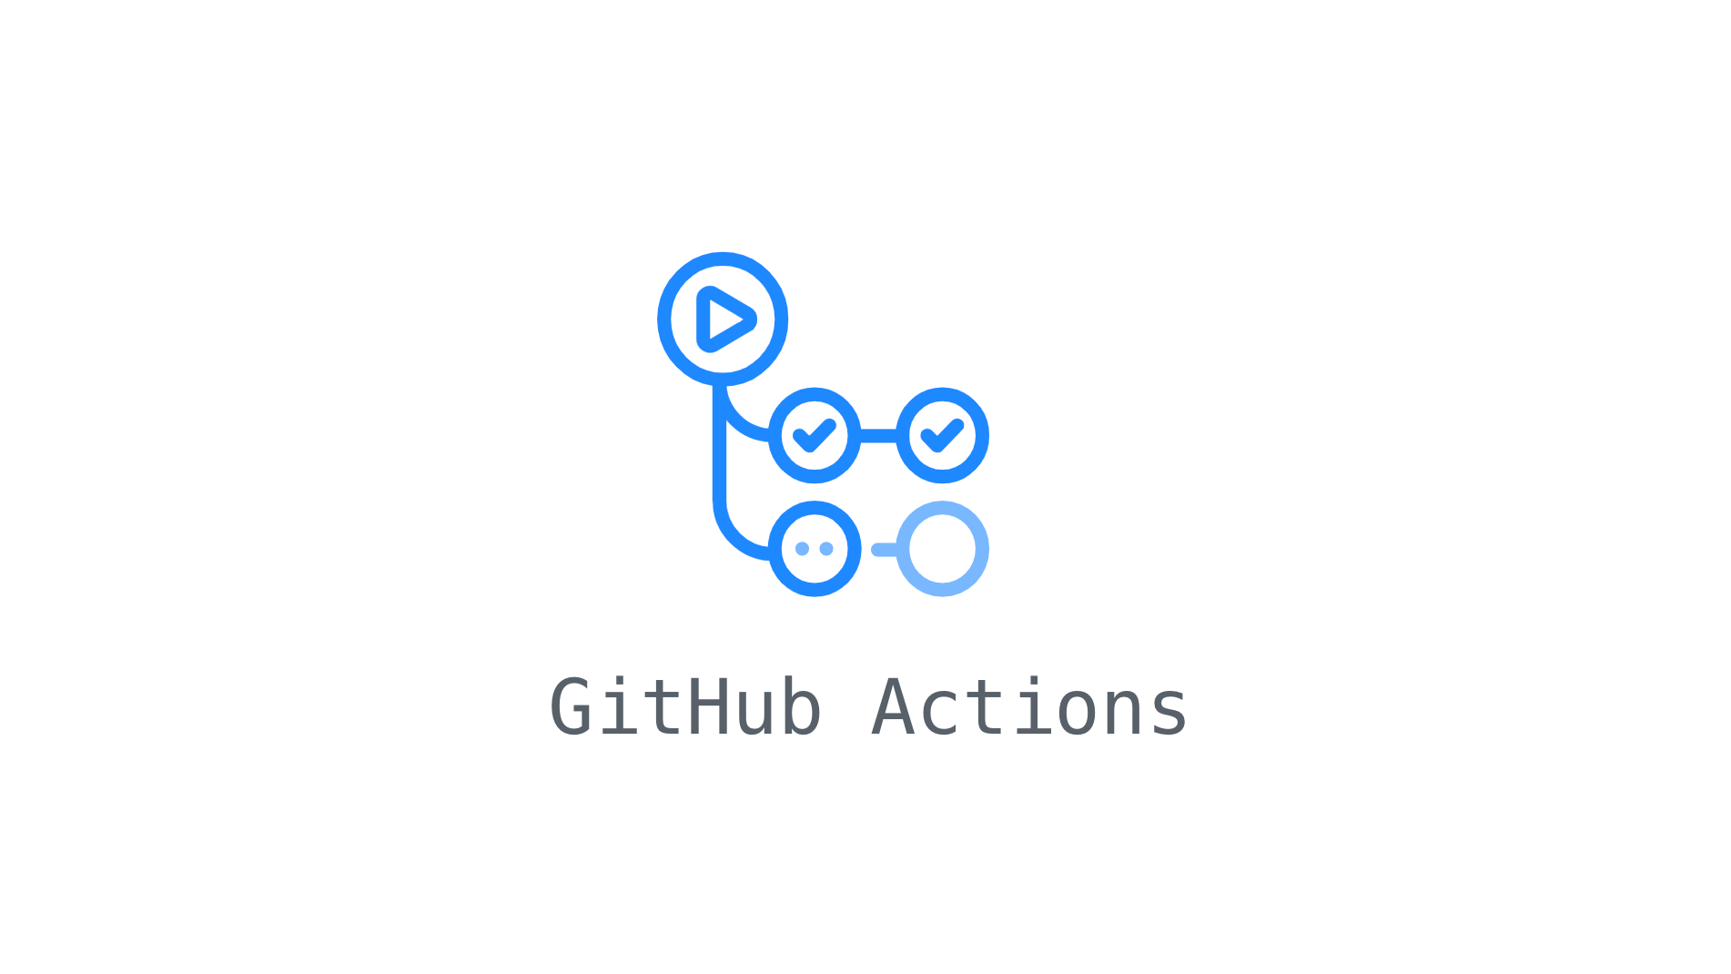




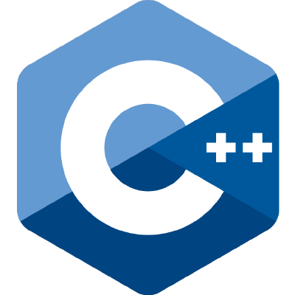
Automate the boring stuff
Human reviewers are expensive and valuable
Focus their time on what matters!
Use agreed-upon tools and settings to handle routine tasks
Code formatting tools for style
Static analysis (linters) to catch common problems
Other quality checks (CodeClimate etc)
Continuous integration to ensure all checks are run
Flake8/pylint
mypy
bandit
lint
clang-tidy

Slide 19

Identify barriers to automation
Bad habits make it hard to use good tools
If you can’t install/run code, CI won’t work
Avoid: hard-coded paths or undocumented configuration
Database setup/migrations should be automated so that every test is run against a realistic environment
Code should be broken into pieces that allow unit testing
Make small improvements in each cycle
Maintenance required: Automation is a shared responsibility

Slide 20
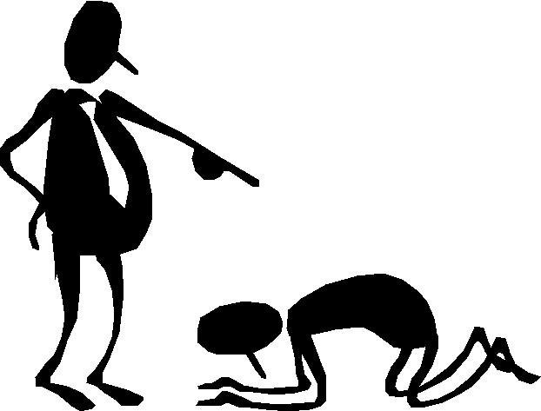
Create shared expectations
Good guidelines are:
Realistic and based on the needs of the project
Agreed upon by the team, rather than imposed
Subject to revision over time
Set a culture of communication
Respectful: criticize code, not people
Flexible: open to discussion and alternatives
Curious: ask questions for the sake of learning

Slide 21
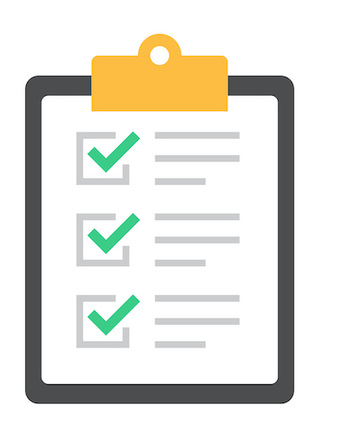
Example checklist: Web Applications
Features: are complete and work as intended
Documentation: code comments, docstrings, and specs
Compliance: meets regulatory obligations (IRB, accessibility, etc)
Maintainability: change is readable & thorough; include artifacts & tests
Performance/scalability: site won’t crash under heavy use
Privacy/security: access controls, code injection, etc
Risk assessment: can a change be rolled back if it causes problems?
Not listed: Architecture. Discuss that before you start coding.
Notes:
In a large organization, not all these items will be the responsibility of the developer. For example, lawyers and security teams may have a role in ensuring compliance. As programmers, we want to be at least aware of these obligations, but also willing to ask for help when needed.
In web applications, security is looked at from multiple directions:
Protect user data from your code (authentication, authorization)
Protect your code from untrusted user data (XSS, SQL injection, shell commands delegated to external programs, etc)
This means that some of the most important bugs are not obvious only from the code- you must also consider sample data that the program would be used with. For some example categories of problem, see:
https://github.com/minimaxir/big-list-of-naughty-strings/blob/master/blns.txt

Slide 22
Different checklists for different audiences
General code review:
https://www.michaelagreiler.com/code-review-checklist-2/
By and for scientists:
http://fperez.org/py4science/code_reviews.html
https://uwescience.github.io/neuroinformatics/2017/10/08/code-review.html
Journal of Open Source Software: manuscripts about code
https://joss.readthedocs.io/en/latest/review_checklist.html
OWASP Security Guides
https://owasp.org/www-project-top-ten/
https://owasp.org/www-pdf-archive/OWASP_Code_Review_Guide_v2.pdf
Accessibility
https://www.a11yproject.com/checklist/
Language specific style guides
https://google.github.io/styleguide/cppguide.html

Slide 23
Making it work
Common challenges and how to address them

Slide 24
Challenge: Process/alignment
People may come in with different expectations and can’t agree on whether an item needs to be addressed.
Possible causes:
The feedback is burdensome or does not address a specific problem
Eg automated tools that cause too much friction: fix or remove them
Project planning issues
Delivery deadlines must include time for review and testing
Poor sense of long-term goals for project (“sure this function uses a lot of RAM, but it works on my sample file!”)
Review is seen as a “final grade” instead of an ongoing process
The team should create a set of shared guidelines, and revise them over time

Slide 25
Challenge: Communication
Review is a dialogue. Sometimes additional information is required to turn notes into action: the problem/fix may not be immediately obvious. Follow-up is required.
For the reviewer:
When introducing new concepts, can you link to a good explanation?
Is the fix within the technical abilities of the developer?
For the code author:
Keep good notes so you can explain what was already tried, and what didn’t work
Don’t try to bluff the reviewer or “make the problem go away”
For everyone:
Be willing to say “I don’t know”, and then learn
Notes:
“Bluffing” is when a question is answered with impressive but nebulous sentences meant to shut the discussion down. For example, “this code disables authentication- because of *SECURITY*!”.
This sets a bad tone for discussion- but it is also a sign that the author may not fully understand the code or settings that are being changed. As a reviewer, learn to spot the signs of uncertainty: code that the team does not understand is a place where bugs can hide.

Slide 26
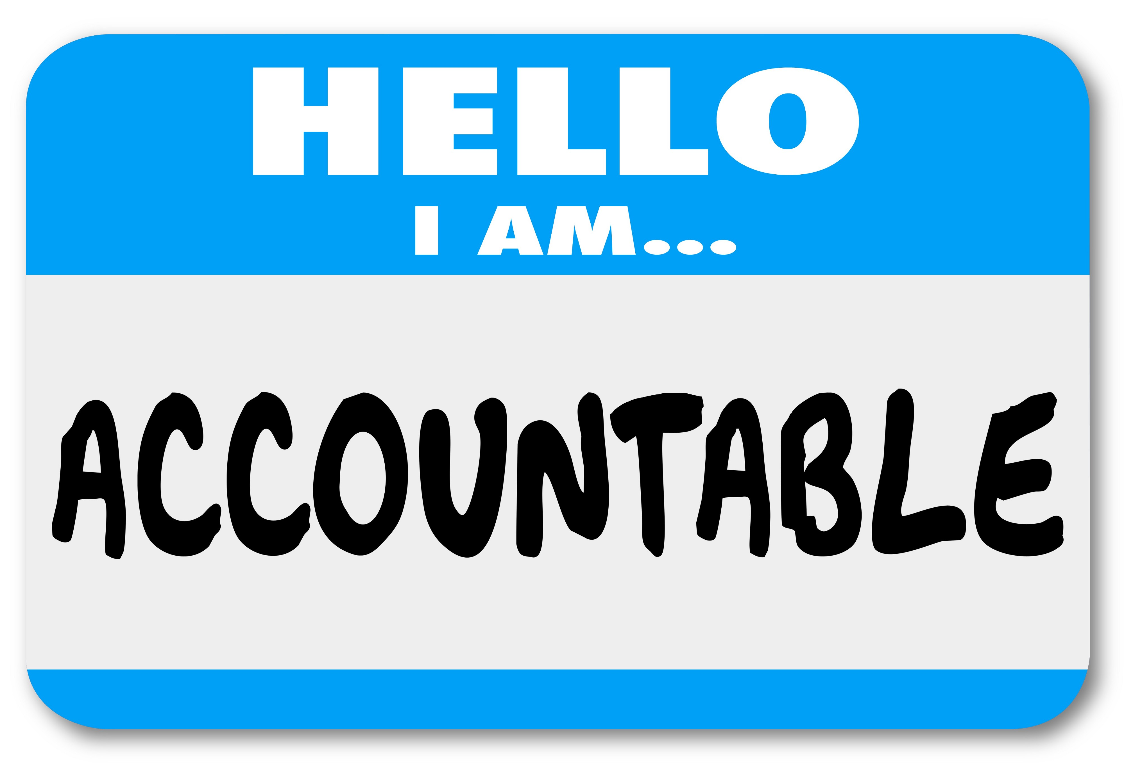
Challenge: Advocacy
Sometimes, a problem is important, and even urgent to fix... but the solution is tedious. Someone needs to advocate for the work.
Identify the constraint: time? Resources? Specialized expertise?
Create a plan for implementing the fix, and expect to follow through
Designate a specific person who is accountable, and set a time to report back
Avoid “maintenance” as a separate job: elevate continuous improvement
Notes:
Ask “why” instead of “why not”. When taking a stand, show how this change creates a path forward or fits with future plans.... but learn from counter arguments and be open to alternatives based on evidence.
Trust is built over time.

Slide 27
Challenge: Domain
The code may be hard to review due to required domain knowledge or highly specific optimization. Pieces will be complex and interconnected.
“Correct” output may be unknown: capture validation as you go
Algorithm may be hard to determine solely from code: how to document?
Different baseline testing approach: common SWE practices must adapt
Author was focused on testing the science, not the code
Code may only be subjected to review at the end of the process
May have only been validated on huge slow datasets: how to iterate?
Jay, C. et al. The challenges of theory-software translation. F1000Res 9, 1192 (2020). (link)
Notes:
It may not be feasible to implement the “best” process. Start by creating a climate where discussion is possible. It may not be the perfect review process, but even small discussions can help.

Slide 28
Demonstration
“Our principal findings are that scientists are enthusiastic, but need to be shown code review in action, and that just-in-time review of small code changes is more likely to succeed than large-scale end-of-work review “
Petre, M. & Wilson, G. Code Review For and By Scientists. arXiv:1407.5648 [cs] (2014). (link)
Notes:
In practice I really want a better domain-specific demo; this might be entirely optional in a live talk. (Finding a good demo that spans skill levels is very hard: it may be sufficient to stick with the language exercise and select a set of task-specific demos for follow-up discussions)

Slide 29

Good Code Review is:
A way to share ideas and experience
A peer activity focused on outcomes
Small, incremental, and frequent
A shared responsibility for everyone
Most effective when used with other good habits

Slide 30
Further reading: Code Review
How to read other people’s code
https://selftaughtcoders.com/how-to-quickly-and-effectively-read-other-peoples-code/
Conducting effective code reviews: Tips, phases, and sample ideas
https://auth0.com/blog/conducting-effective-code-reviews/#Different-Aspects-of-a-Code-Review
“Software Engineering at Google: Ch 9”
https://learning.oreilly.com/library/view/software-engineering-at/9781492082781/ch09.html#code_review-id00002
How to make good code reviews better
https://stackoverflow.blog/2019/09/30/how-to-make-good-code-reviews-better/
MIT student code review guide
https://web.mit.edu/6.005/www/fa15/general/code-review.html

Slide 31
Further reading: Software Engineering
Good enough practices in scientific computing
https://journals.plos.org/ploscompbiol/article?id=10.1371/journal.pcbi.1005510
US Research Software Engineer Association
https://us-rse.org/newsletters/
Software Sustainability Institute (Guides on many topics)
https://www.software.ac.uk/resources/guides/guides-developers
https://software.ac.uk/sites/default/files/SSI-SoftwareEvaluationCriteria.pdf
Prior presentations
Unit testing: https://github.com/abought/slides/blob/gh-pages/csg/automated-testing/boughton-software_testing_slides_2019_07_30.pdf
Debugging: https://github.com/abought/slides/blob/gh-pages/csg/debugging-techniques/boughton_debugging_techniques-2020_02_25.pdf

Slide 32


When review fails
Unclear expectations: poorly described code, no shared goals
Diffuse teams: No clear responsibility for fixes or follow-up
Barriers to entry: eg specialized infrastructure/ secret data that takes longer to set up than the actual code review
Undue burden: eg too much code all at once
Knowledge transfer: difficult on small teams, or with long time lag between authors
“Hey, just look at this repo by tomorrow and tell me what you think, ok?”
https://github.com/microsoft/MS-DOS
I was hired to do UX...

Slide 33
“Just another voice in support of the notion that code review should be focused much more on knowledge transfer and shared good practice (i.e. the learning is bidirectional) than on bug finding. In an environment where most code is written by students, who have a known rate of turnover, it’s a way to guarantee that successor students have an understanding of the code that will become their responsibility and the basis of their research projects. There’s a corollary to this, which is that students can’t be allowed to carry their code too far “out into the wilderness”... Otherwise, you’ll have students who spend the last year or whatever before they graduate grinding out the last... results... and then they leave with no one else ever having looked at it...”
-Phil Miller, via USRSE Slack
Notes:
Special thanks to Phil Miller, Jeffrey Carver, and other participants on USRSE slack for helpful feedback and suggestions. Jeffrey Carver inspired and shared some language exercise ideas (though I have tried to avoid using his examples, to avoid spoiling the surprise- his talk seems worth watching if you have the chance!).

Slide 34
“Debugging is twice as hard as writing the code in the first place. Therefore, if you write the code as cleverly as possible, you are, by definition, not smart enough to debug it.”
-Kernighan's law
Notes:
This is a fun pithy quote, but its meaning has admittedly shifted over time.
See this Reddit thread for some nice historical context: https://www.reddit.com/r/programming/comments/f5adfa/kernighans_law_debugging_is_twice_as_hard_as/fhy3pd8/

